Slide 1
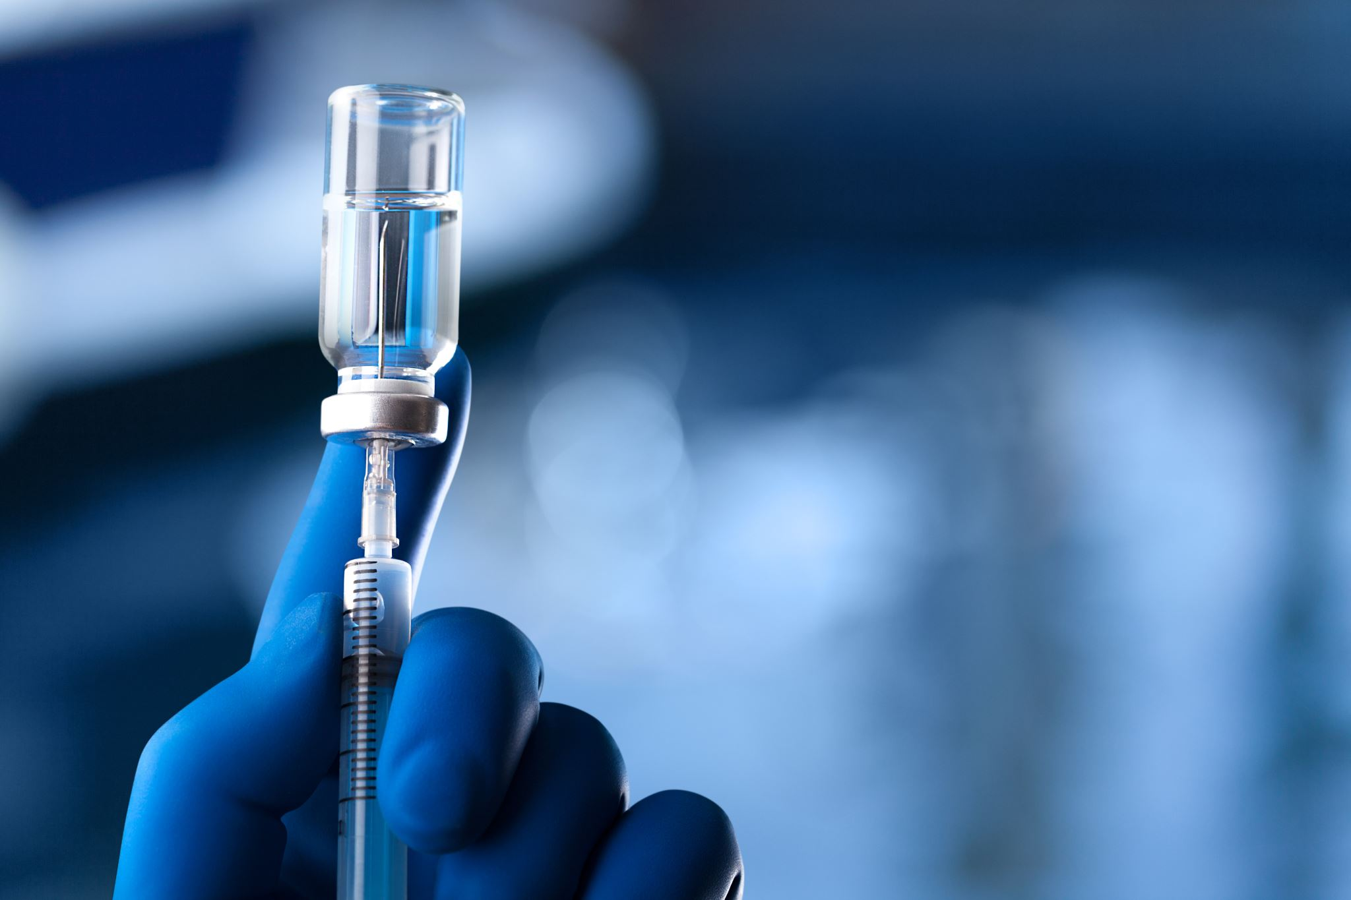
Thyroid Diagnosis with ML
Thyroid disease using machine learning
Team Members
P . Veera
T . maharaja
S . Kishore

Slide 2

Duration
36 Days
Overall Project Progress 0%
Mentor Instructions : Refer the project Description Milestones , activities , and referens tounderstand the project deliverables. Provide your Github Details to collaborate with the project workspace repository.

Slide 3
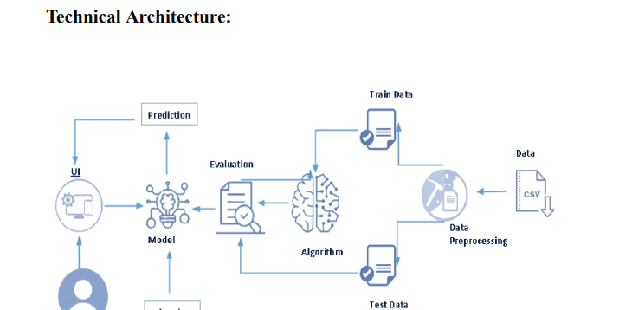


Slide 4

Project Structure: Create the Project folder which contains files as shown below
We are building a flask application which needs HTML pages stored in the templates folder and a python script app.py for scripting. • thyroid_1_model.pkl is our saved model. Further, we will use this model for flask integration. • Training folder contains model training files and the training_ibm folder contains IBM deployment files.

Slide 5
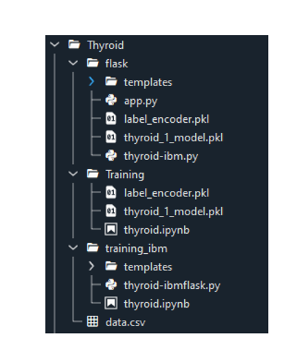
Project Flow: ● The user interacts with the UI to enter the input. ● Entered input is analysed by the model which is integrated. ● Once the model analyses the input the prediction is showcased on the UI To accomplish this, we have to complete all the activities listed below, ● Define Problem / Problem Understanding ○ Specify the business problem ○ Business requirements ○ Literature Survey ○ Social or Business Impact. ● Data Collection & Preparation ○ Collect the dataset ○ Data Preparation ● Exploratory Data Analysis ○ Descriptive statistical ○ Visual Analysis ● Model Building ○ Training the model in multiple algorithms ○ Testing the model ● Performance Testing & Hyperparameter Tuning ○ Testing model with multiple evaluation metrics ○ Comparing model accuracy before & after applying hyperparameter tuning ● Model Deployment ○ Save the best model ○ Integrate with Web Framework ● Project Demonstration & Documentation ○ Record explanation Video for project end to end solution ○ Project Documentation-Step by step project development procedure

Slide 6
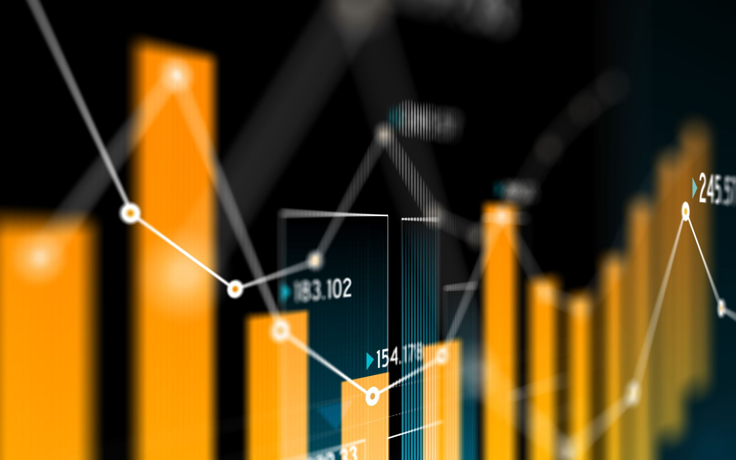
Visual Analysis
Visual analysis Visual analysis is the process of using visual representations, such as charts, plots, and graphs, to explore and understand data. It is a way to quickly identify patterns, trends, and outliers in the data, which can help to gain insights and make informed decisions. Activity 2.1: Checking Correlation. Here, I'm finding the correlation using HeatMap. It visualizes the data in 2-D coloured maps making use of colour variations. It describes the related variables in the form of colours instead of numbers; it will be plotted on both axes. Here, there is no correlation between columns.

Slide 7
Model Building
Activity 1: Training the model in multiple algorithms Now our data is cleaned and it’s time to build the model. We can train our data on different algorithms. For this project we are applying four classification algorithms. The best model is saved based on its performance. Activity 1.1: Random Forest Classifier Model A function named Random Forest Classifier Model is created and train and test data are passed as the parameters. Inside the function, the Random Forest Classifier algorithm is initialized and training data is passed to the model with the .fit() function. Test data is predicted with the .predict() function and saved in a new variable. For evaluating the model, accuracy_score and classification report is done.

Slide 8
Model Deployment
Model Deployment Activity 1:Save the best model Saving the best model after comparing its performance using different evaluation metrics means selecting the model with the highest performance and saving its weights and configuration. This can be useful in avoiding the need to retrain the model every time it is needed and also to be able to use it in the future. Activity 2: Integrate with Web Framework In this section, we will be building a web application that is integrated to the model we built. A UI is provided for the uses where he has to enter the values for predictions. The enter values are given to the saved model and prediction is showcased on the UI. This section has the following tasks • Building HTML Pages • Building server side script Activity 2.1: Building Html Pages: For this project create three HTML files namely • home.html • predict.html • submit.html and save them in the templates folder. Let’s see how our home.html page looks like

Slide 9
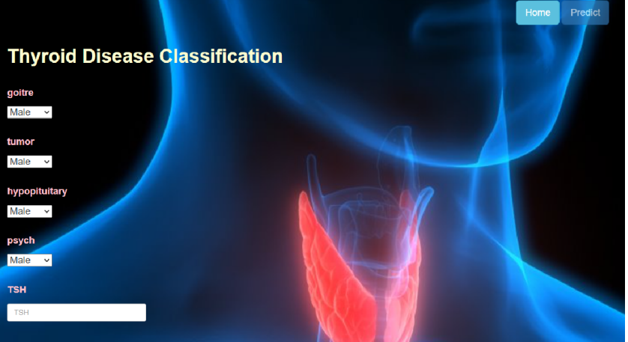

Slide 10
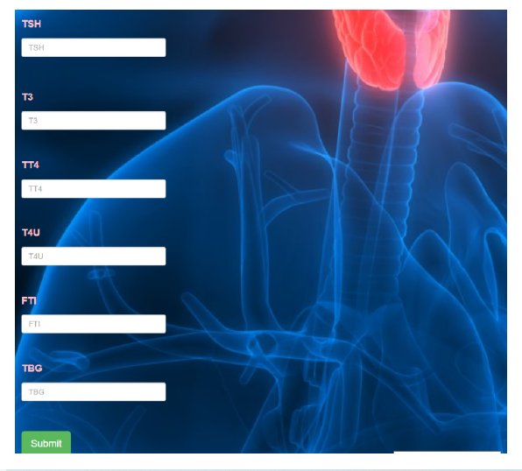

Slide 11
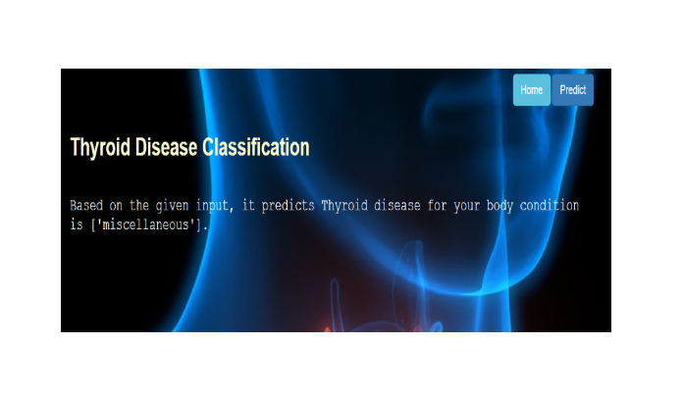

Slide 12

Thank you For Your Attention

